Slide 1

Hearing Loss, prevention, & Management
Preparing musicians and sound engineers for long-term hearing health
Dr. Jonathan Mikhail, M.S., AuD., FAAA

Slide 2

Nearly one in four adults, 24% of the populous in the United States have an audiometric noise-induced, or a musician’s notch, on a hearing evaluation (Carroll et al., 2017).
Notes:
https://www.internetvibes.net/2021/01/15/what-you-should-do-when-struggling-to-hear/

Slide 3
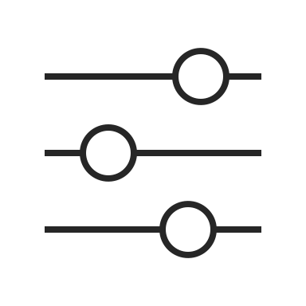
Unhealthy Levels of Sound Exposure
Noise Induced Hearing Loss (NIHL) is considered one of the most common occupational illnesses in the United States and in Europe (Neitzel and Fligor, 2019).
An industrial rule is any consistent noise over an 8-hour period at 85dBA or more, hearing protection should always be worn.

Slide 4
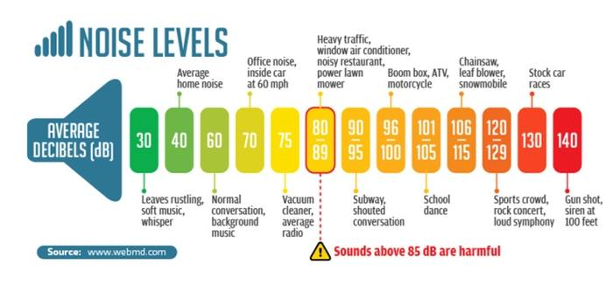
Notes:
https://soundproofingguide.com/decibels-level-comparison-chart/

Slide 5

Unhealthy Levels of Sound Exposure
For every 3dB change in the average exposure level, the allowable exposure duration can be halved or doubled.
For example:
  Using a 3dB rule, a noise exposure of 85dBA on average for eight hours has identical risk of NIHL over time as an exposure of 88dBA for four hours, 91dBA for two hours, 94dBA for one hours, and so on (NIOSH, 1998).
To put it simply, the louder something gets after 85dBA, the sooner NIHL will occur in the listener.

Slide 6
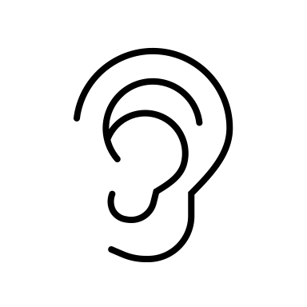
Symptoms of NIHL
Musicians and sound engineers both report, as a symptom of NIHL, aural fullness and tinnitus (Ntlhakana and Heliopoulos, 2020).
Aural fullness: ear pressure or a clogging sensation of the ear (Park et al., 2012).
  Chronic exposure to noise at excessively high volumes can also attribute to aural fullness in listeners.
Tinnitus: the conscious expression of a sound that originates in an involuntary manner in the head of its owner (McFadden, 1982).
  Much of tinnitus is caused by prolonged and repeated noise exposure.

Slide 7
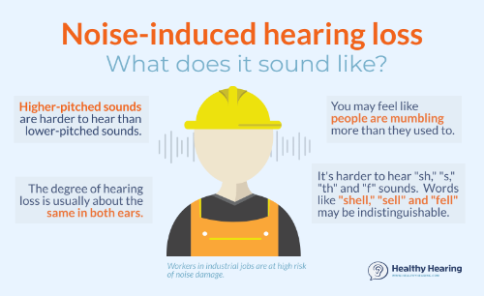

Slide 8
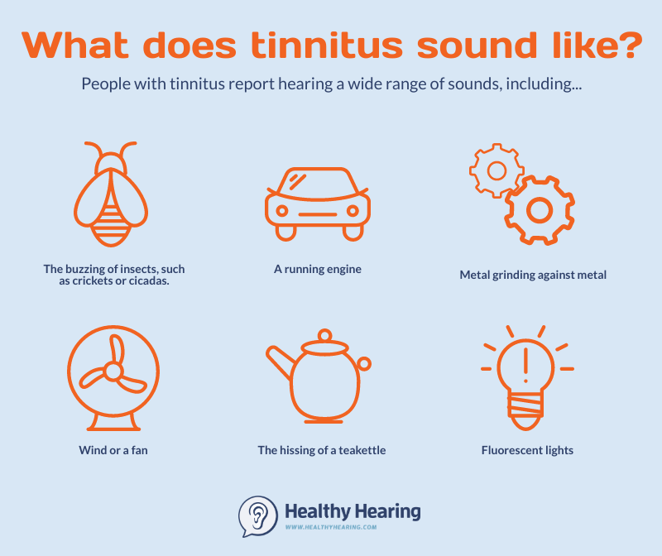
Notes:
https://www.healthyhearing.com/uploads/images/What-does-tinnitus-sound-like-hh19.jpg

Slide 9
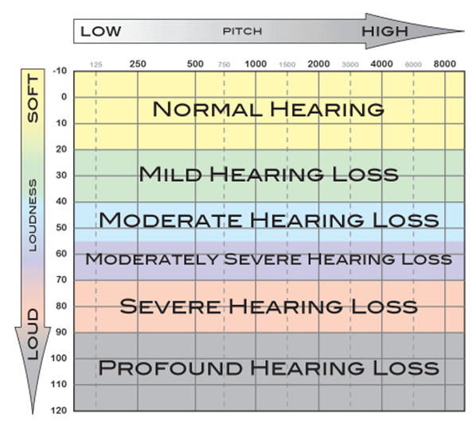
How to read an audiogram
Notes:
http://www.nationalhearingtest.org/wordpress/wp-content/uploads/2014/05/Audiogram.png

Slide 10
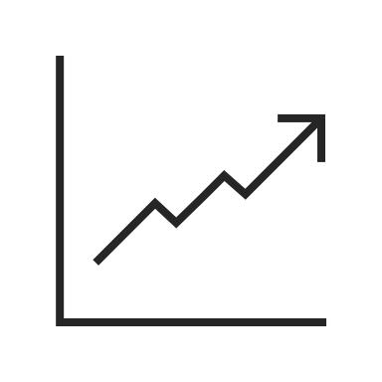
Symptoms of NIHL Part 1
Temporary Threshold Shifts (TTS)
  TTS can be defined as threshold shifts that recover to baseline levels in the hours, days, or weeks, following noise exposure (Ryan et al., 2016).
  Recovery time will vary between person to person based on the amount of noise exposure and an individual’s own ear characteristics.
  Typical TTS occurs at frequencies the same or slightly higher than the frequency of the exposing sound in the environment.
  TTS can cause communicative issues, tinnitus, as well as aural fullness upon the individual experiencing high levels of noise (National Research Council, 2004).
  TTS can turn into permanent threshold shifts (PTS).

Slide 11
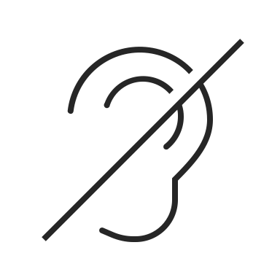
Symptoms of NIHL Part 2
Permanent Threshold Shifts (PTS):
  A PTS is when hearing has shifted at a value greater than 10dB from 2000Hz-4000Hz, respectively.
  PTS can cause communicative issues, tinnitus, as well as aural fullness upon the individual experiencing high levels of noise (National Research Council, 2004).
  The greater the level or the longer the duration of the exposing sounds, the greater the likelihood of a PTS following a TTS.

Slide 12

Symptoms of NIHL Part 3
Noise-induced notch (musician’s notch):
  Can be viewed on an audiogram, occurring between 3000Hz-6000Hz (oftentimes 2000Hz), with the most common frequency being at 4000Hz (McBride and Williams, 2001).
  3000Hz notches can be correlated with low-frequency noises.
  4000Hz notches are most associated with chronic noise exposure.
  6000Hz notches most likely indicate impulse noise exposure.

Slide 13
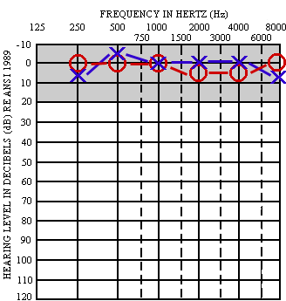
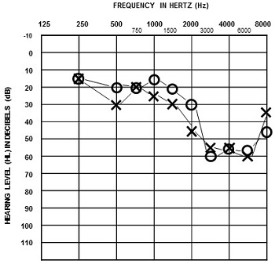
Normal Hearing
Musician’s “Notch”
X = Left Ear
O = Right Ear
Notes:
https://dizziness-and-balance.com/testing/images/audionm1.gif
https://4f9f43c1b16d77fd5a81-7c32520033e6d1a7ac50ad01318c27e4.ssl.cf2.rackcdn.com/content/c15200/c15268/092115fligorslide21rightfig4.jpg

Slide 15
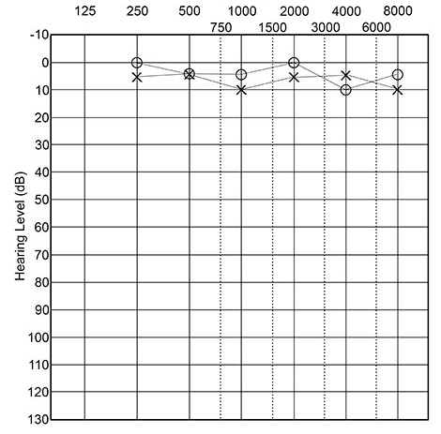
Normal Hearing
Notes:
Click on each speaker icon to play an example of the song, “Are You Gonna Be My Girl” by Jet, at different levels of hearing loss.
https://www.babyhearing.org/what-is-an-audiogram

Slide 16
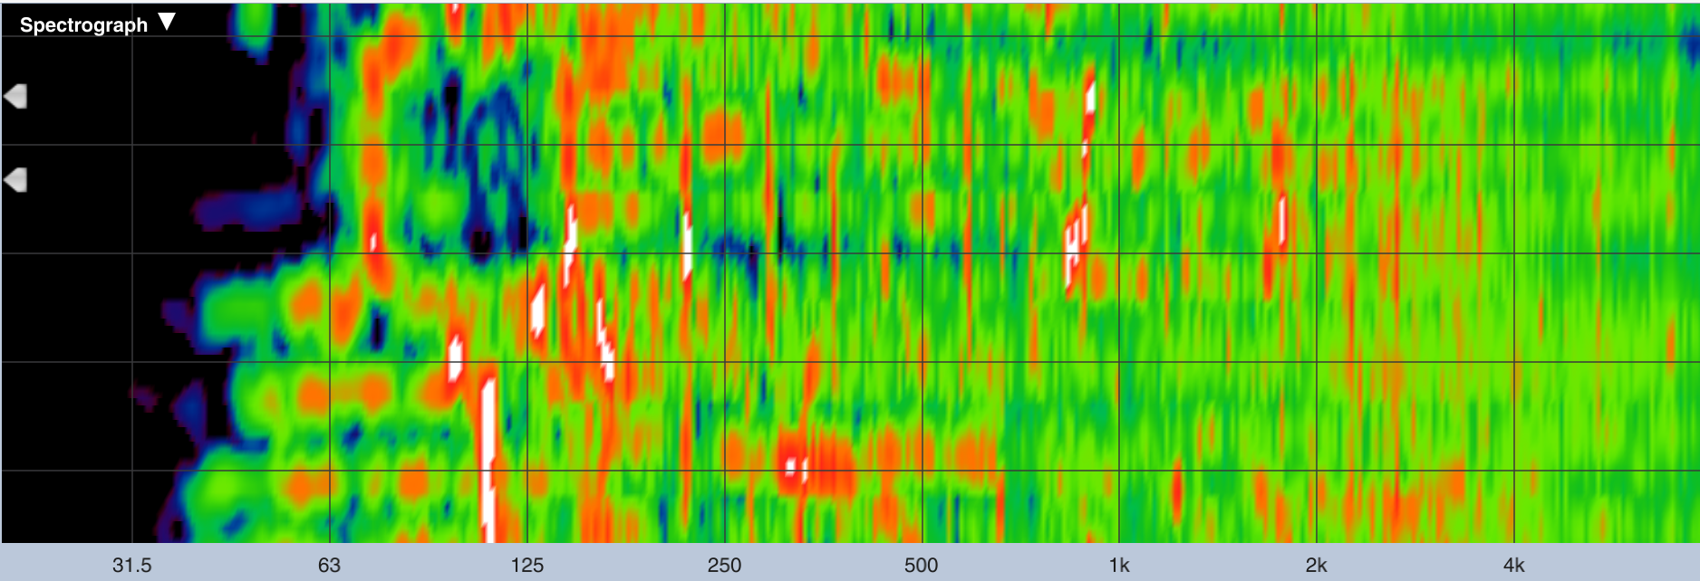
Normal Spectrograph
Merchant, 2022

Slide 17
Mild Hearing Loss: Musician’s Notch @ 2000HZ
Notes:
Click on each speaker icon to play an example of the song, “Are You Gonna Be My Girl” by Jet, at different levels of hearing loss.

Slide 18
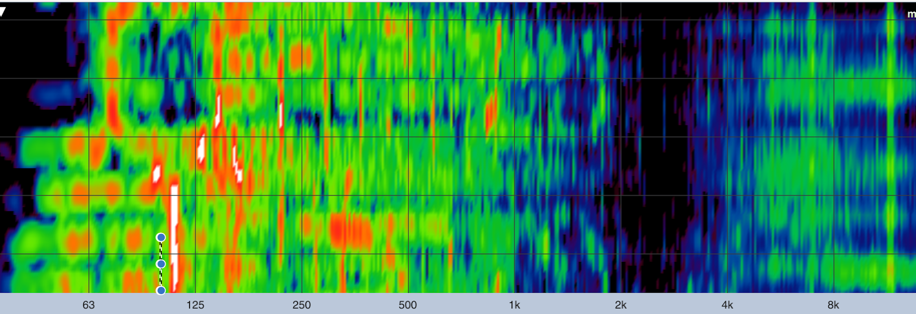
2000Hz Spectrograph
(Look at how much energy has dissipated at 2000Hz)
Merchant, 2022

Slide 19
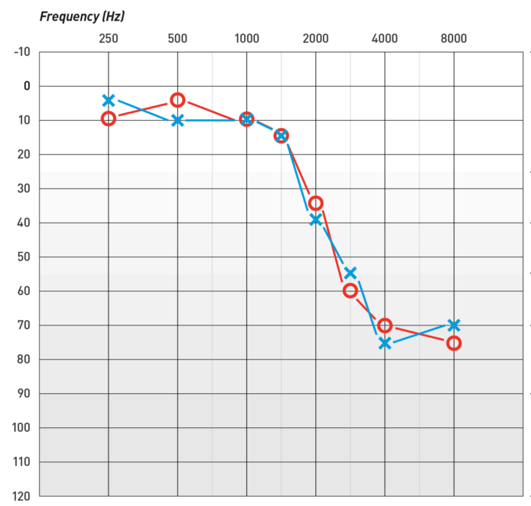
Mild/Moderate High-Frequency Hearing Loss
6000Hz-8000Hz
Normal Hearing
Notes:
Click on each speaker icon to play an example of the song, “Are You Gonna Be My Girl” by Jet, at different levels of hearing loss.

Slide 20
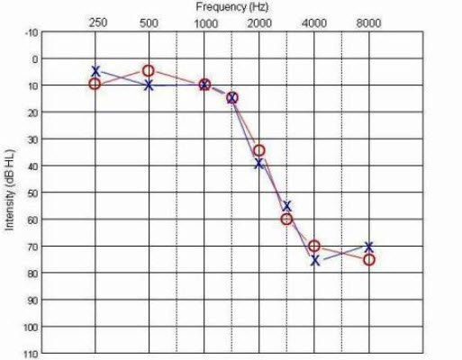
Severe Mid/High-Frequency Hearing Loss 2000Hz-8000Hz
Normal Hearing
Notes:
Click on each speaker icon to play an example of the song, “Are You Gonna Be My Girl” by Jet, at different levels of hearing loss.

Slide 21
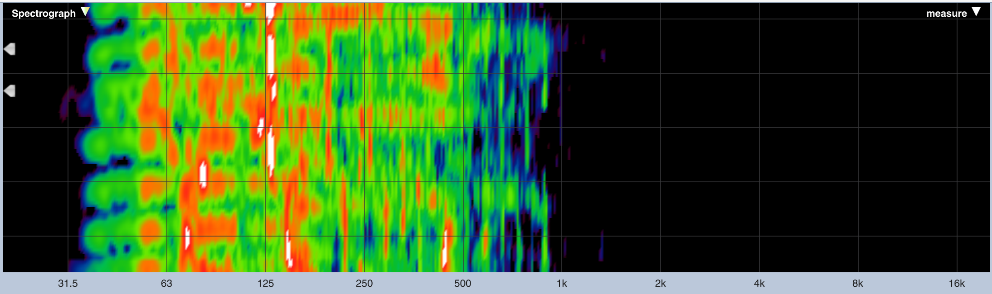
Severe high-frequency Spectrograph
Merchant, 2022

Slide 22
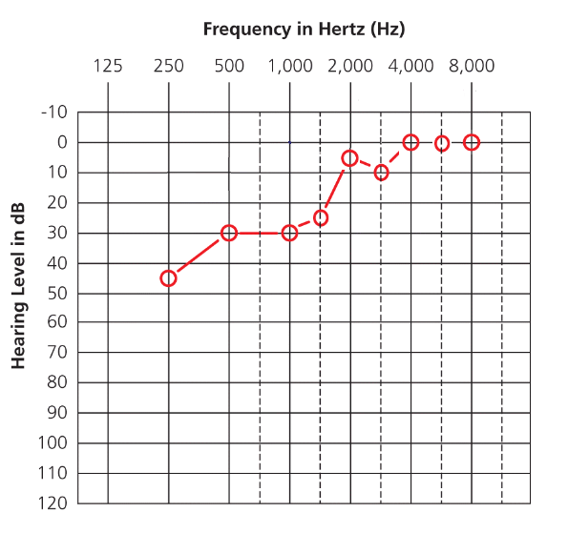
Moderate Low-Frequency Hearing Loss 250Hz-500Hz
Notes:
Click on each speaker icon to play an example of the song, “Are You Gonna Be My Girl” by Jet, at different levels of hearing loss.

Slide 23
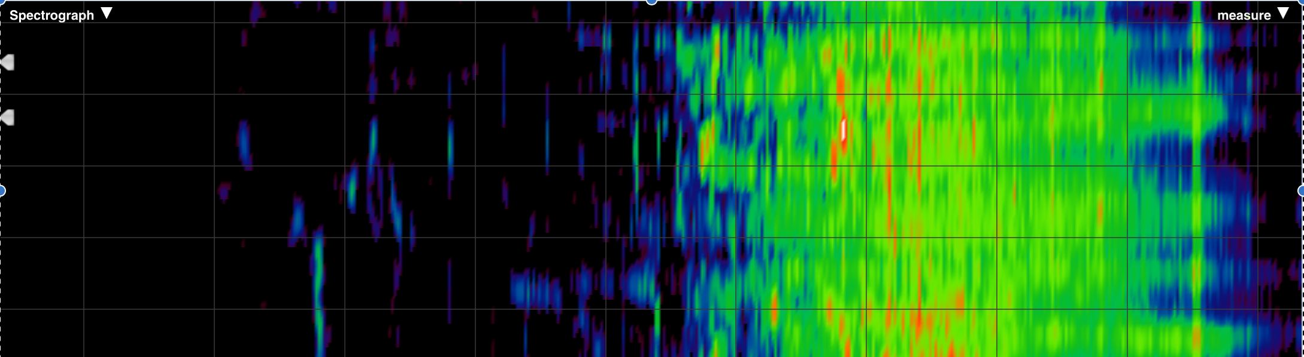
Low-frequency Spectrograph
Merchant, 2022

Slide 24
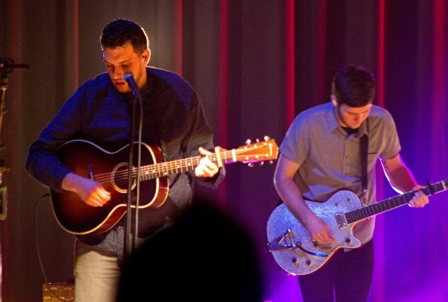
Implications of NIHL
Most professional musicians practice or perform up to eight or more hours per day, depending on performance rate (Einhorn, 2009).
Previous literature has indicated that sound pressure levels (SPLs) musicians encounter lie within hazardous ranges that can extend to 120-130dBA.
Most rock and pop musicians are only 3 feet from an amplifier or monitor, making sounds direct to the player or sound engineer’s ears.

Slide 25
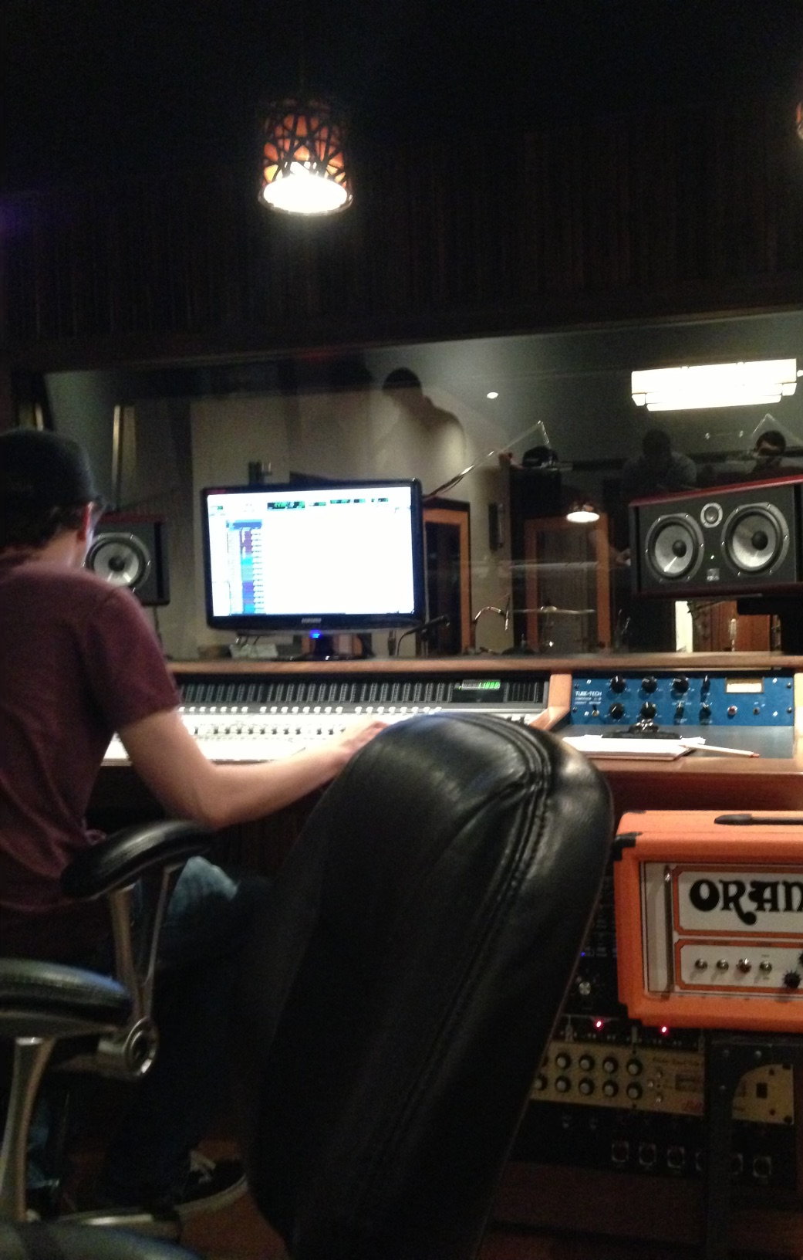
Implications of NIHL
High frequencies are vitally important to musicians and sound engineers due to the broad range of frequencies that must accurately be matched.
Frequencies can be above normal speech frequencies.
Causes a musician and sound engineer to increase volume in order to hear something appropriately, which only results in more unhealthy levels of noise exposure.

Slide 26

Implications of NIHL
Music-Induced Hearing Loss (MIHL):
  Often asymmetric (more hearing loss in one ear vs. the other).
  Occurs due to the positioning of onstage monitors, instruments, or amplifiers.
  Asymmetric hearing loss raises the complaints of players and sound engineers about distortion, even in the better ear (Chasin, 1996).
  Asymmetry causes localization issues, binaural hearing cues to be skewed, issues understanding speech in competing noise environments, loss of socialization, and work productivity (Snapp and Ausili, 2020).

Slide 27

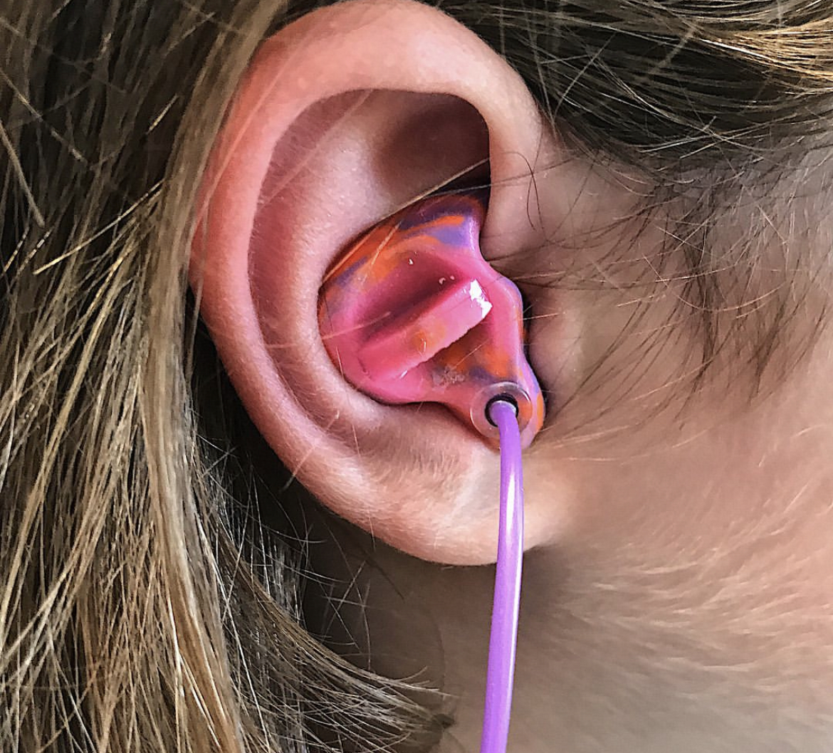
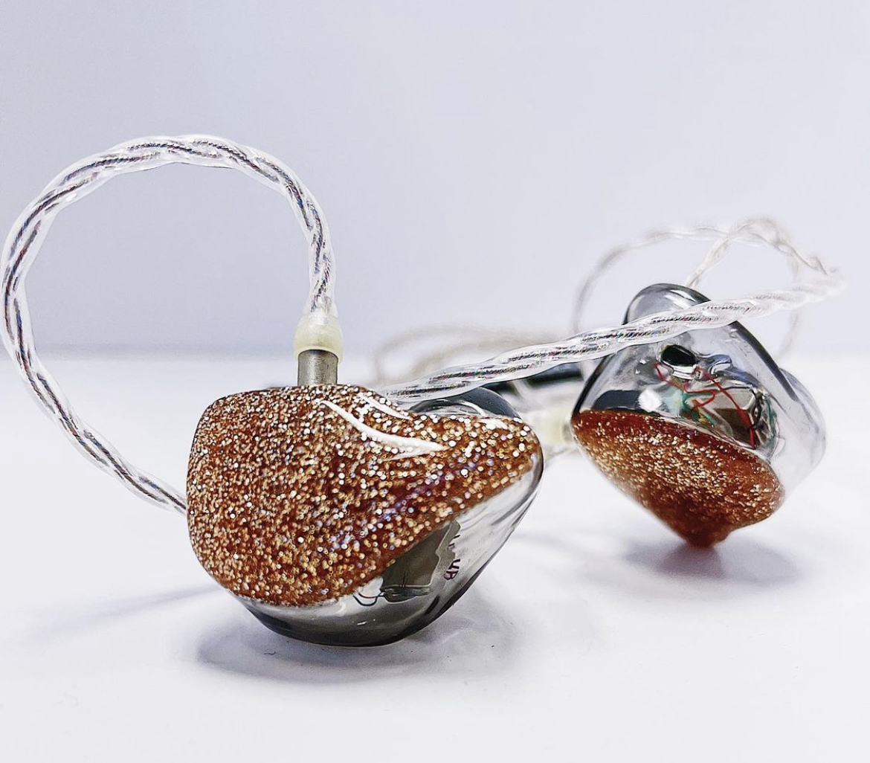
Hearing Loss Prevention
Hearing loss prevention starts with you.
  In-ear monitors
  Earmuffs
  Universal earplugs
  Custom earplugs
  Download dosimeter app
Most importantly, keep the volume down.
  Be aware of exposure time on personal devices

Slide 28
References
Carroll, Y. I., Eichwald, J., Scinicariello, F., Hoffman, H., Deitchman, S., Radke, M., C., & Breysse, P. (2017, February 10). Vital signs: Noise-Induced hearing loss among adults. Center of Disease Control. https://www.cdc.gov/mmwr/volumes/66/wr/mm6605e3.htm
McBride, D., & Williams, S. (2001). Audiometric notch as a sign of noise induced hearing loss. Occupational and Environmental Medicine, 58(1), 46– 51. https://doi.org/10.1136/oem.58.1.46
Merchant, J. (2022, March 8). Spectrograph stills [Photograph]. In We Transfer Video Image.
Neitzel, R. L., & Fligor, B. J. (2019). Risk of noise-induced hearing loss due to recreational sound: Review and recommendations. Journal of the Acoustical Society of America, 146(5), 3911–3921. https://doi.org/10.1121/1.5132287
Ntlhakana, L., & Heliopoulos, A. (2020). The hearing function of sound engineers: A hearing conservation perspective. South African Journal of Communication Disorders, 67(1), 1–7. https://doi.org/10.4102/sajcd.v67i1.638
Occupational noise exposure (n.d.). Occupational Safety and Health Administration. Retrieved June 7, 2021, from https://www.osha.gov/noise/hearing-programs
Park, M. S., Lee, H. Y., Kang, H. M., Ryu, E. W., Lee, S. K., & Yeo, S. G. (2012). Clinical manifestations of aural fullness. Yonsei Medical Journal, 53(5), 985–991. https://doi.org/10.3349/ymj.2012.53.5.985
Ryan, A. F., Kujawa, S. G., Hammill, T., Le Prell, C., & Kil, J. (2016). Temporary and permanent noise-induced threshold shifts. Otology & Neurotology, 37(8), 271–275. https://doi.org/10.1097/mao.0000000000001071
Snapp, H., & Ausili, S. (2020). Hearing with one ear: Consequences and treatments for profound unilateral hearing loss. Journal of Clinical Medicine, 9(4), 1010–1023. https://doi.org/10.3390/jcm9041010

Slide 29
Contact Information
Email: jonathanmikhail@live.com
Clinic: Area Hearing & Speech Clinic, INC. Joplin, Missouri
LinkedIn: Jonathan Mikhail, Doctor of Audiology
Instagram: @areahearing

